Slide 1
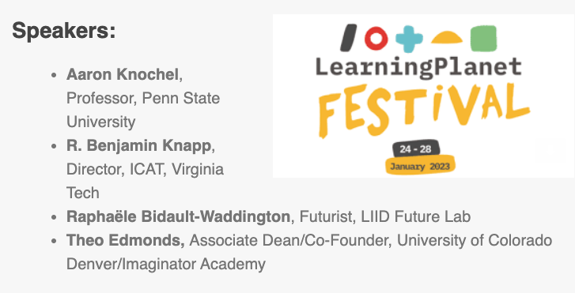

Slide 3
Overview
Creativity
Disciplinarity
Discussion
The promise of artistic research for future challenges
Final thoughts

Slide 4
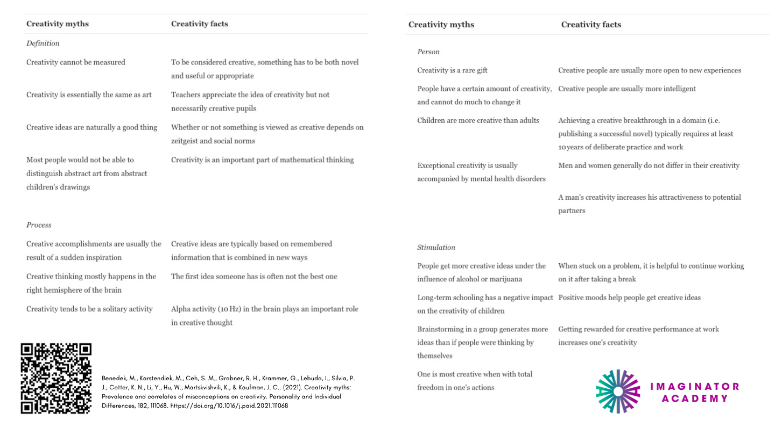

Slide 5
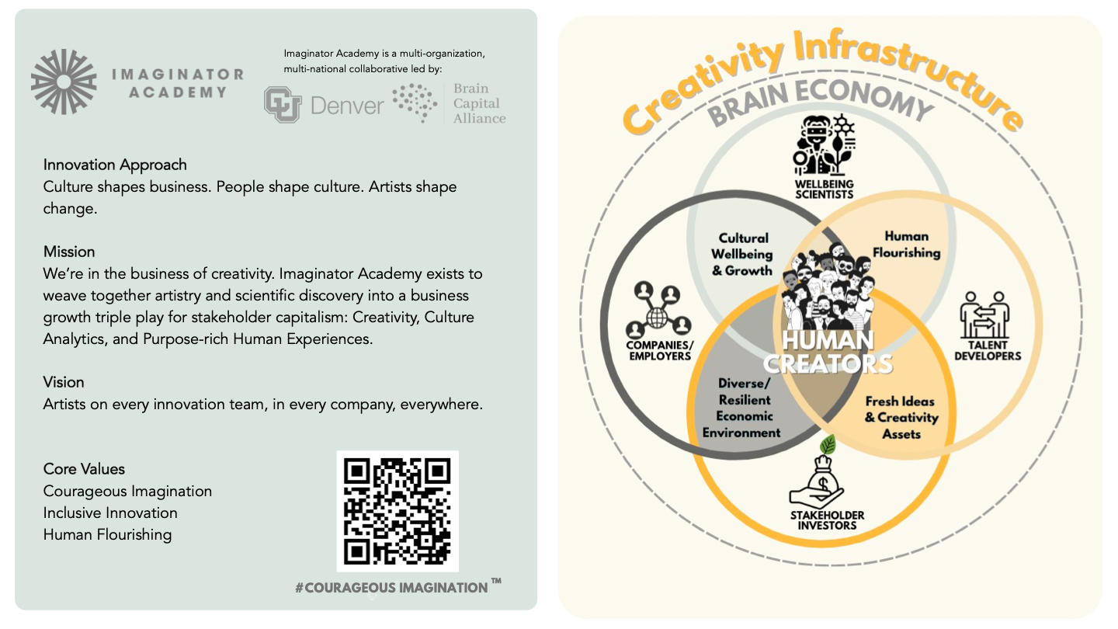

Slide 8
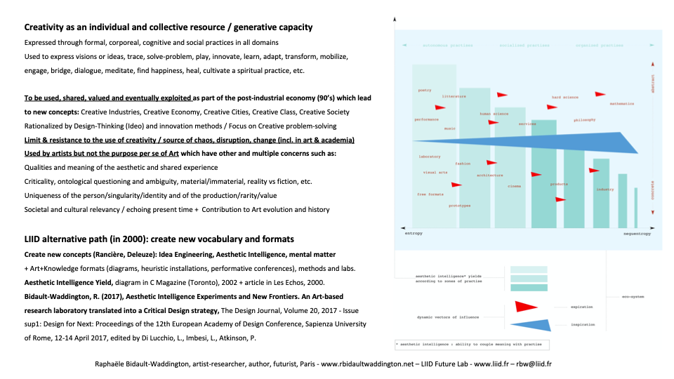

Slide 9
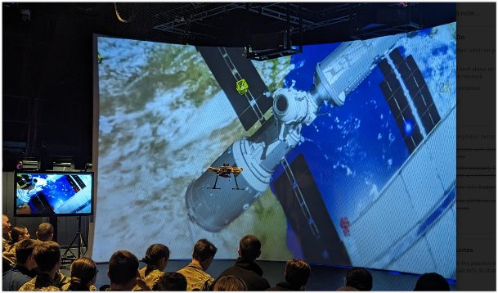

Slide 10
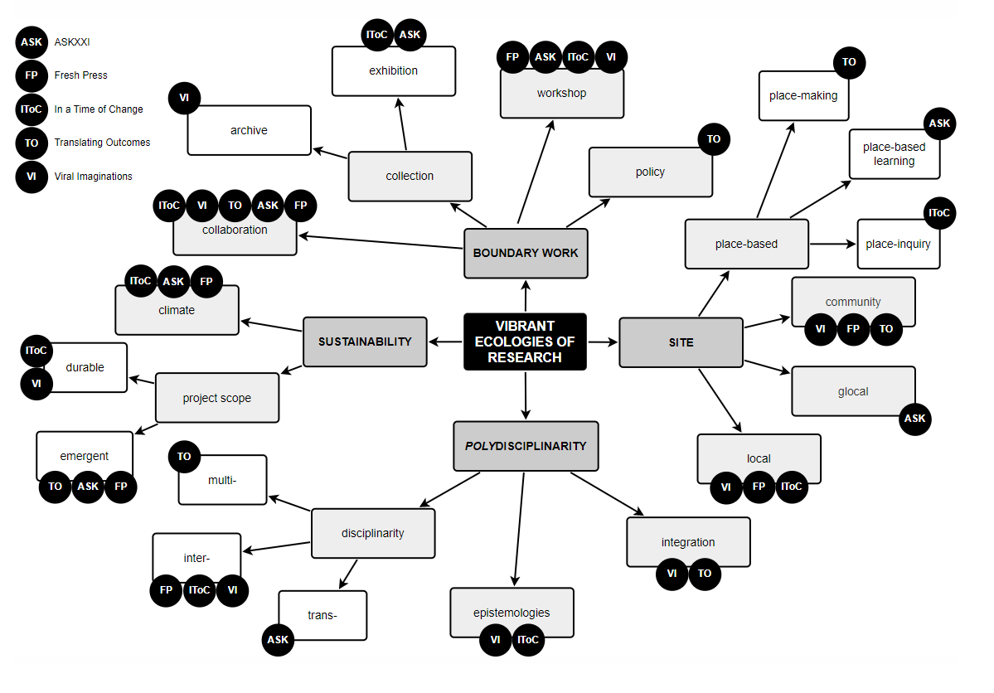

Slide 11
groundworks.io

Slide 13
Discussion

Slide 14
“There is a real situation, that can’t be denied, but it is too big for any individual to know in full, and so we must create our understanding by way of an act of the imagination.”
― Kim Stanley Robinson, The Ministry for the Future, 2020

